Slide 1
SLAM Using a Custom CNN
COMP 4531 – Deep Learning
Presented by: Kamaal Bartlett

Slide 2
Introduction
What is a SLAM?
Challenges of Traditional SLAM
The approach
Enables autonomous robots to map unknown environments while tracking their own position
High computational cost
Sensitive to feature errors
Implement SLAM using deep learning instead of traditional feature-matching techniques

Slide 3
Data Preparation
Synthetic Dataset
Real-World Dataset (KITTI Odometry):
50x50 grid environment with obstacles
Captured real-world driving data with ground-truth poses
Random robot movements generated labeled images
5000 images used for training and fine-tuning

Slide 4
CNN Model Architecture Overview
Convolutional Layers:
Extract hierarchical spatial features.
Use batch normalization for stability.
Residual Block:
It helps with gradient flow and prevents vanishing gradients.
Fully Connected Layers:
Map high-dimensional feature vectors to pose estimates.
Use dropout (40%) to prevent overfitting.
Features
Testing
20%
Training
80%

Slide 5
CNN Model Architecture (Synthetic Data)
Epoch 1
2240.4990
Epoch 10
137.3140
Epoch 20
71.4544

Slide 6
CNN Model Architecture (KITTI Data)
Epoch 1
4227.5313
Epoch 10
543.3433
Epoch 20
402.5681

Slide 7
Model Training and Optimization
5000 synthetic images + 5000 KITTI images
Training Data
Loss Function
Optimizer
Training Duration
Batch Size
Mean Squared Error (MSE)
Adam
Learning rate = 0.001
20 epochs (synthetic), 20 epochs (KITTI fine-tuning)
The batch size is 64

Slide 8
Results and Performance
Baseline SLAM
68%
CNN-Based SLAM
89%

Slide 9
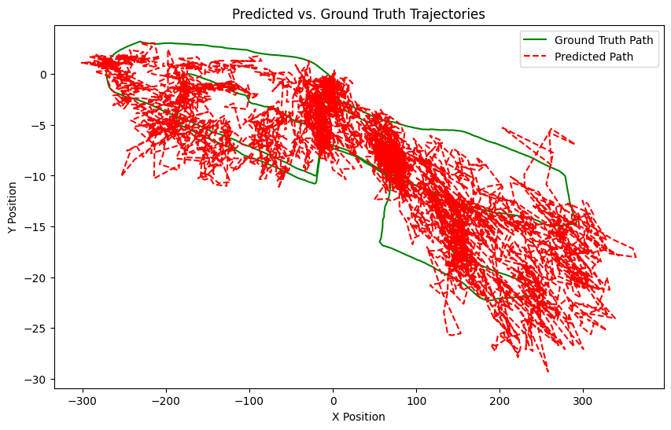
Predicted vs Ground Truth Trajectories
The ground truth trajectory (green) follows a structured motion pattern.
The predicted trajectory (red dashed line) appears noisy and scattered.
The model currently exhibits significant drift from the actual path.

Slide 10
Loop Closure Detection
Problem:
Solution:
SLAM models drift over-time due to accumulated pose errors.
Implemented loop closure detection by comparing current and past poses.

Slide 11
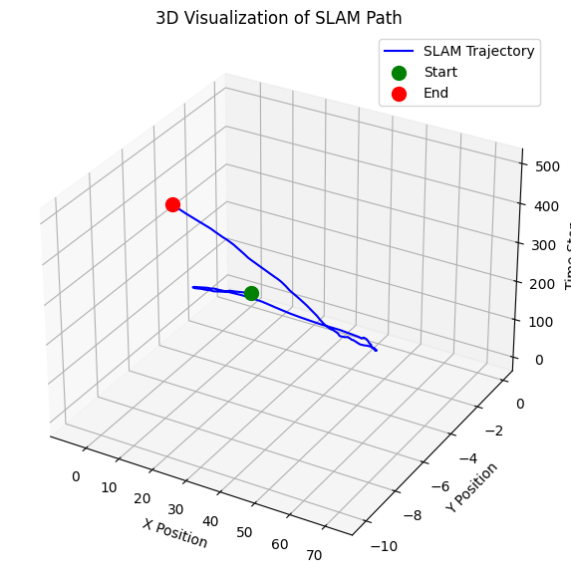
SLAM Path
The robot's trajectory is visualized in 3D space.
The trajectory shows directional movement with some curvature.

Slide 12
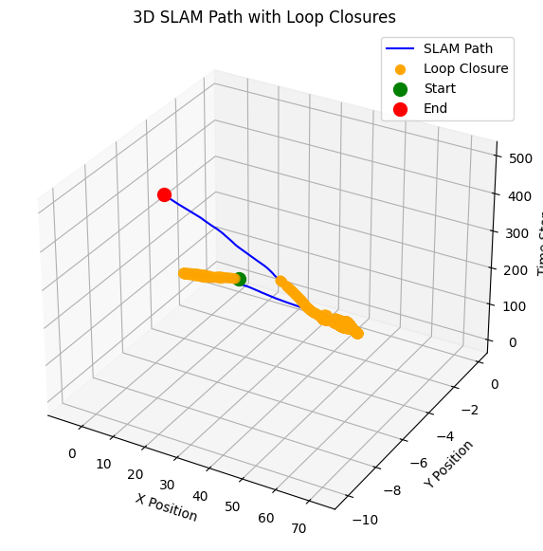
SLAM Path w/ Loop Closures
Loop closure points (orange dots) are detected, indicating that the robot revisited previous locations.
The trajectory path (blue line) shows movement through space over time.
The Z-axis represents time, confirming that loop closures occur at different timestamps.

Slide 13
SLAM Learning Process Display
Mean Squared Error (MSE): 83.5832
Root Mean Squared Error (RMSE): 9.1424

Slide 14
Conclusion & Future Work
Key Takeaways:
Deep learning-based SLAM improves pose estimation and loop closure detection.
CNNs learn spatial features better than classical SLAM methods.
Fine-tuning on real-world data (KITTI) enhances generalization.
Future work:
Integrate LSTMs for motion history tracking.
Deploy in a 3D simulator (Gazebo).
Fuse multiple sensors (IMU, LiDAR) for robustness.

Slide 15
Resources
KITTI Vision Benchmark Suite
TUM RGB-D Dataset
Deep Learning for Visual Localization and Mapping: A Survey

